Slide 1


You Show it, We Know It! AI-Enabled Interactive Analytics Platform for UPS Call Centers
Team Members
Sayali Kardile
Katherine King
Quan Le
Hao Nguyen

Slide 2
Project Roadmap
Speech to Text Transcription
Sentiment Analysis
Demo
Steamlit Web App
Business Case
Architecture
Emotion Detector
Notes:
Project roadmap script: -After showing our business case, we will show you the architecture we designed. We coded and implemented 3 artificial intelligence solutions: voice emotion detection, conversion of speech to text, and sentiment analysis of text. We present these in a Streamlit web app.

Slide 3
Voice of the Customer
UPS SMB Customer Churn
Customer Experience
Notes:
UPS’s motto is: Customer First, People Led, Innovation Driven.
We want to listen to our customers – literally *listen* - to how we can avoid churn and improve customer experience.

Slide 4


Business Case
Enhance UPS capability through customization
Verint platform
Business Case
Voice of Customer
Covid challenges to SMBs
Notes:
Existing customer experience initiatives are improving our bottom line. Expanding our analytics on the *voice* of the customer can help.
UPS’ current analytics platform leverages the Verint platform. 10 million calls are transcribed, with covered languages expanding. It does report text-based sentiment, but we understand that it does not directly analyze audio.
Our Hackathon work demonstrates that UPS has in-house the technical capabilities to produce customized and flexible solutions to UPS business cases involving audio and text.

Slide 5
Extended Use Cases
Compare post-call survey with the call itself
Service and sales real-time agent assistance
Sales and service agent monitoring
Expand use of transcripts
Support continued call containment
Continue customization and interaction with Sales
Notes:
For the Hackathon we focused only on analyzing calls after they occur. However, this work can be extended in many ways:
•Incorporating voiced emotion with post-call surveys
•Offering real-time agent assistance
•Agent monitoring, evaluation, and script improvement
•The data from the calls can be used to improve the UPS Chatbot and social media services
•Support diverting calls to alternate channels
•Continue customization by sharing information with Operations, Marketing, and Sales

Slide 6
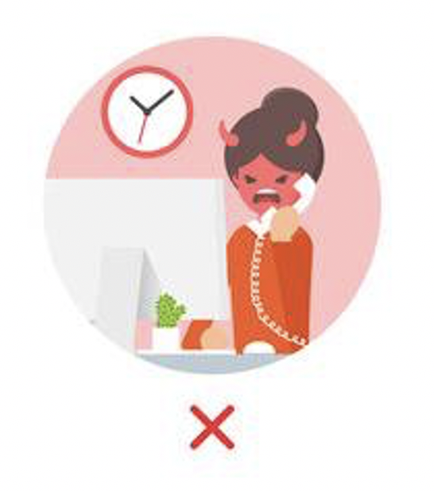
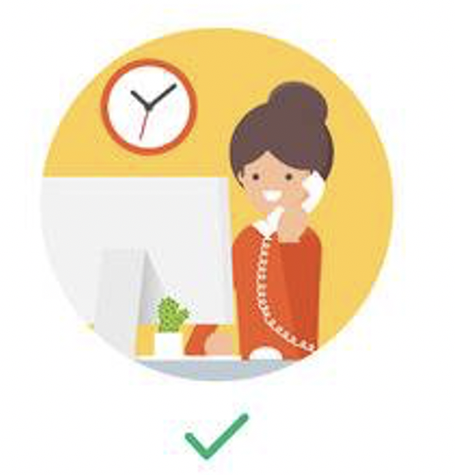
Product Features
callers at risk for churn
build stronger scripts for training agents
Dashboard
customer sentiment
over time/ place/ context
Identify content of calls
Notes:
Our product enables:
*identification of customers at risk for churn
*identify content of calls
Monitor customer sentiment over time and place and by characteristics of customers and shipments
Improve call center operations to build stronger script for training agents

Slide 7
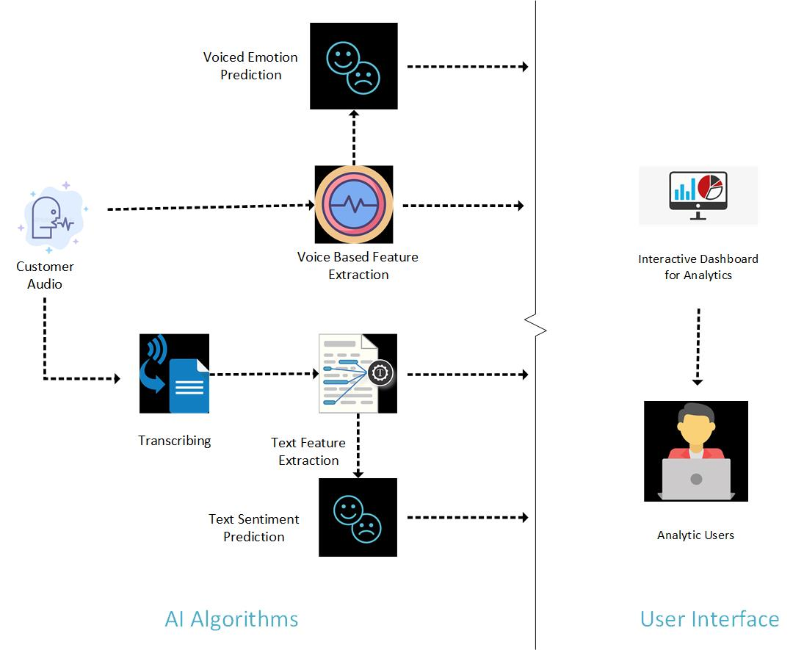
ARCH I TECTURE
Notes:
Thanks Sayali for the introduction. About the architecture of the product, In AI Algorithms side:
•We first extract voice features out of customer audio and use those features to predict the emotions of the speaker
•On the other hand, we transcribe what customer said into text and also do the text feature extraction to predict emotion of the speaker, then we push everything to the user interface side which is an interactive dashboard in our project , and we let analytic user interact with dashboard for further insight. NEXT SLIDE PLEASE !!!

Slide 8
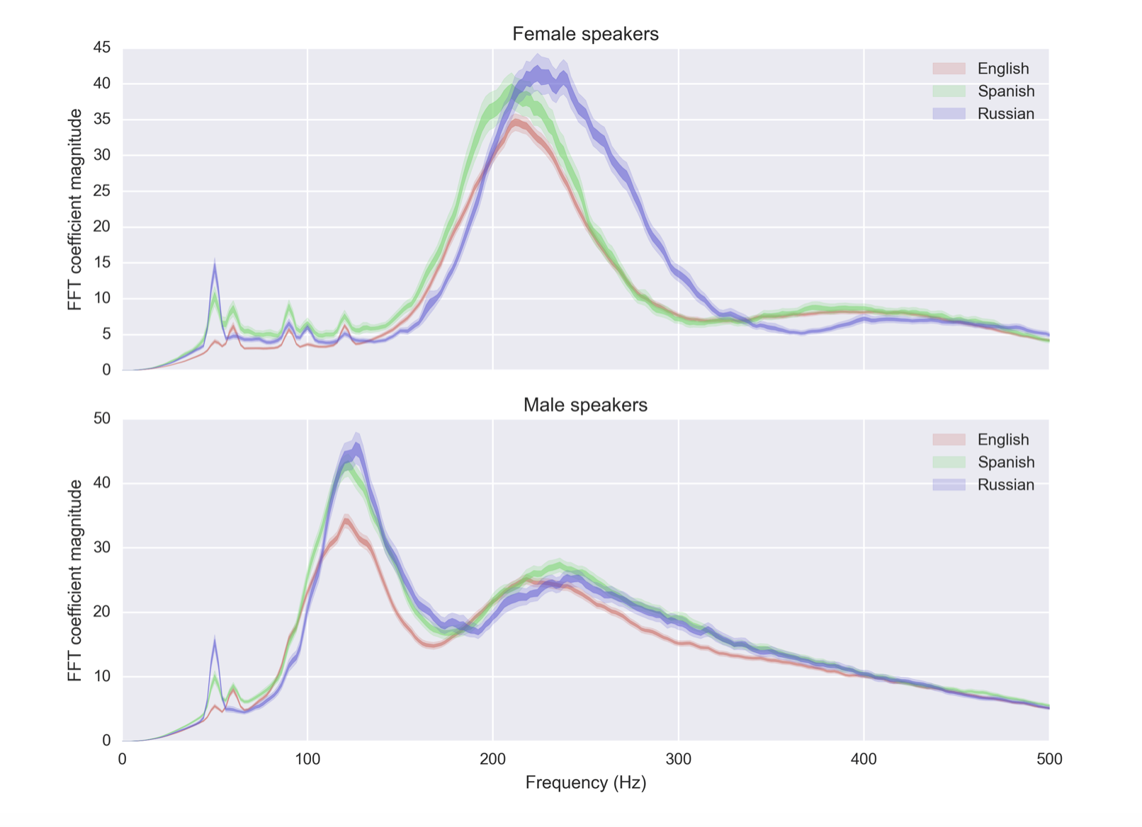
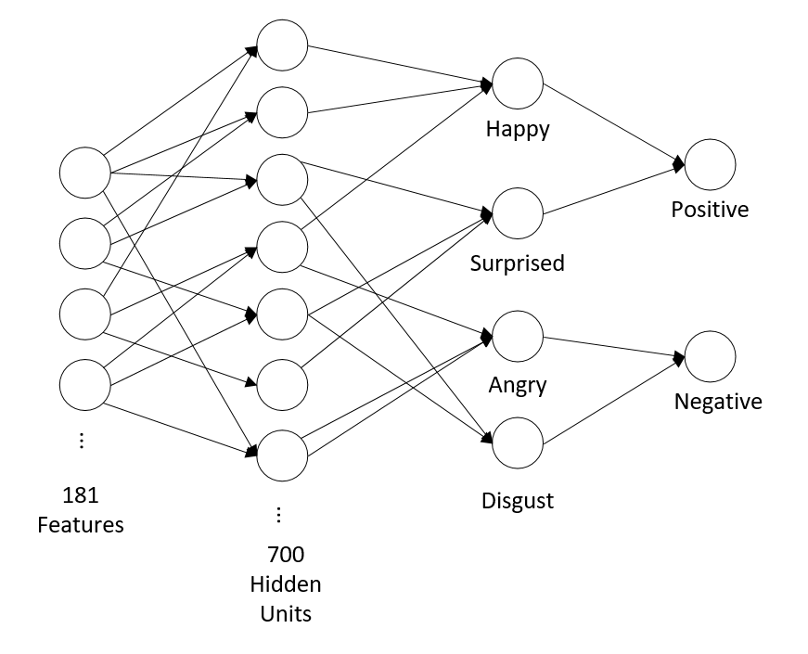
Emotion Detector
MLP Classifier
Sentiments
from
the voice frequency
Different Voice Frequencies
MLP Classifier ML model
Notes:
Regarding the detail on how we detect emotion from voice:
•First, the emotion detection system takes in audio tracks, and extracts features like frequency, cadence, and some other sound features
•And then it put those features into a neural network multilayer perceptron model, and output of the model will be an emotion label which is either Negative or Positive. And Now I pass to Hao for the Text Sentiment Analysis

Slide 9
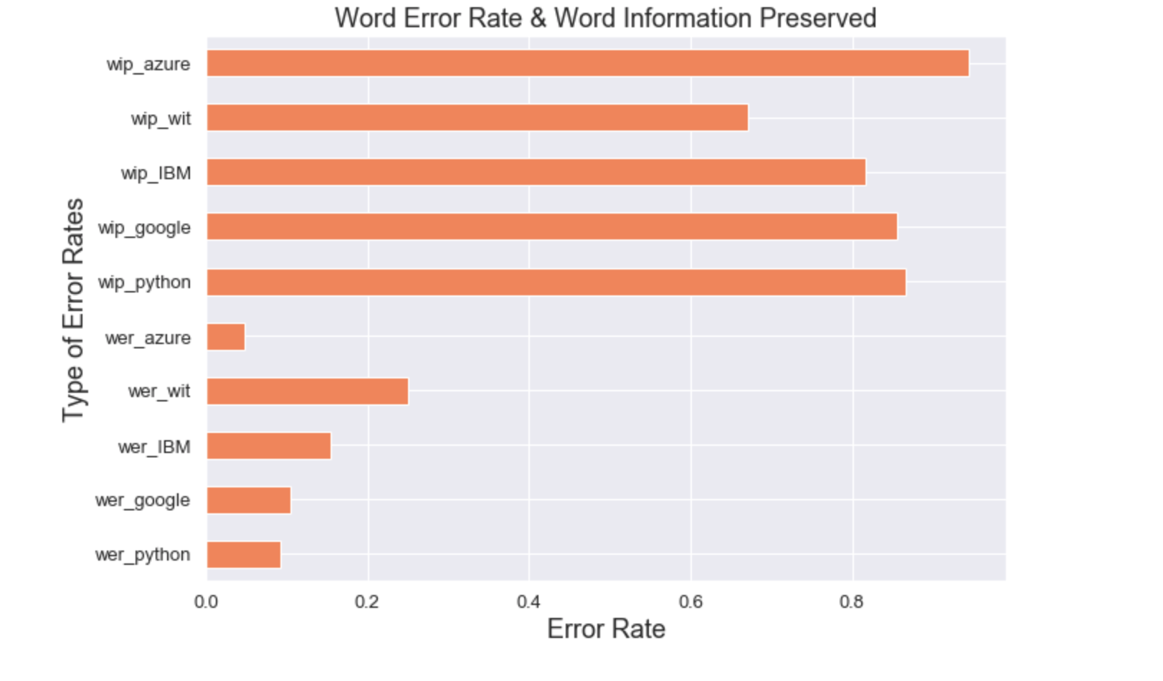
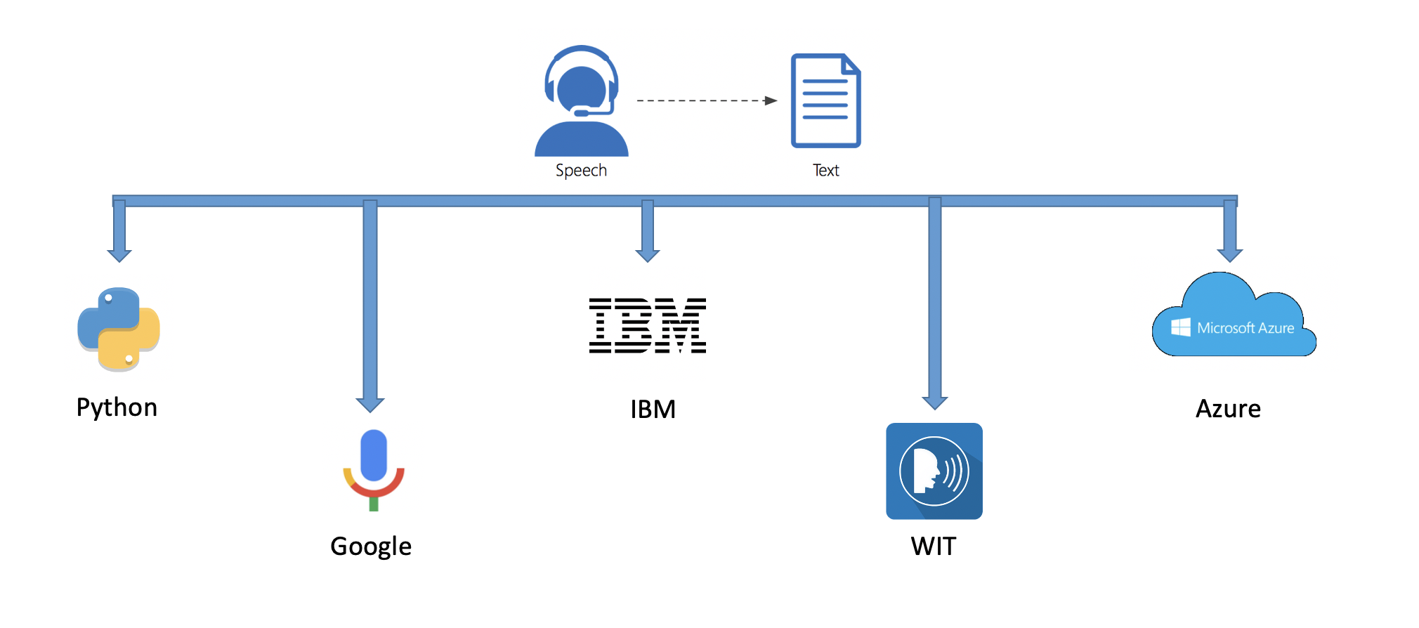
Speech to Text Transcription
Notes:
Transcribing audio involves an API call. Multiple cloud providers offer these APIs. Comparing these providers according to two metrics, Word Error Rate and Word Information Preserved, Azure performed best.

Slide 10
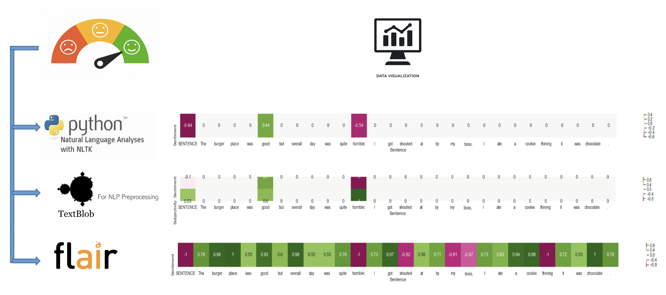
Sentiment Analysis
Flair Model

Slide 11
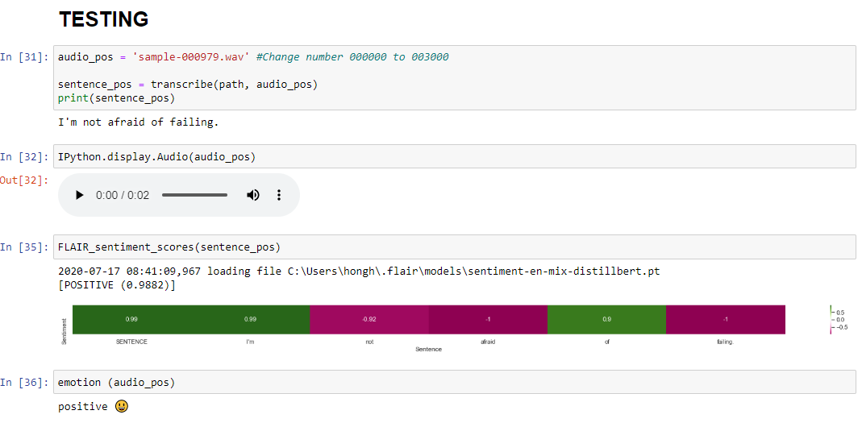
Notes:
Here is an example of testing how multiple algorithms perform at labeling the emotion in one tricky text: ‘I’m not afraid of failing’
both algorithms were able to correctly label the emotion as positive.

Slide 12

Steamlit Web App
What is Streamlit?
An open-source app framework
All in Python, easy to learn
Why do we develop an open-source front end?
Speed time to prototype (no developer required)
Early prototyping enables collaboration with business
Data science considerations reflected in design and interactivity
Reduce cost/integration issues vs. vendor/Power BI
Notes:
Data scientists do not typically build front ends, but bringing front end prototypes into data science has potential. It can speed time to prototype, facilitate communication with the business, allow data science concerns to be reflected in design (including facilitating user inputs and interactivity), and reduce project cost, while using a Python-based framework may have advantages for integration. Streamlit is one of the easiest to learn, which we did specifically for the Hackathon, but for another iteration we could consider Dash, Flask, or Django.

Slide 13

DEMO
Notes:
The business analyst wants to be able to interact directly with the data.
Here, the data is synthetic as use of UPS data is not allowed in the Hackathon.
The raw data can be accessed in this interactive dataframe, you can choose which columns to display.
To identify which calls deserve further attention, we sort by sentiment. If you would like to drill down on a call, you can enter the call number, listen to the call, view the transcription, and record your notes for follow-up here.
Call sentiment can be tracked by customer, shipment, or consignee characteristics to reveal in which groups we have customer experience concerns.
A word cloud is a window into the content of the call. Streamlit allows us to update the word cloud according to the sentiment.
We can also track the sentiment of the calls by location and months into Covid, and with real data these points would update.

Slide 14

THANK YOU

